Slide 1
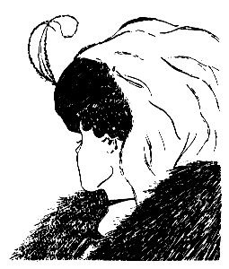
What do you see in this image?
What you find may surprise you!

Slide 2
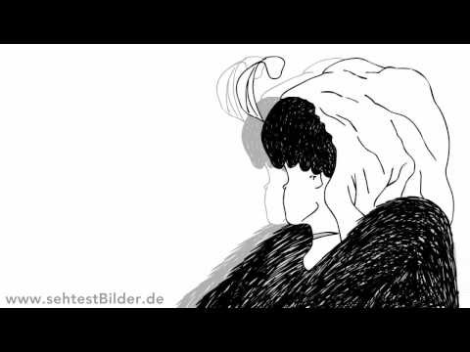
Check this out! It may surprise you!

